Slide 1
Dropout as a Bayesian Approximation for Predictive Maintenance

Slide 2
Content
Bayesian Neural Networks
Variational Inference
Dropout Method
Dropout as a Bayesian Approximation
Extensions
Evaluation Criteria for predictive maintenance
References

Slide 3
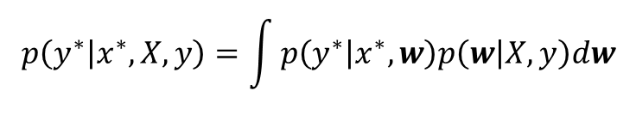
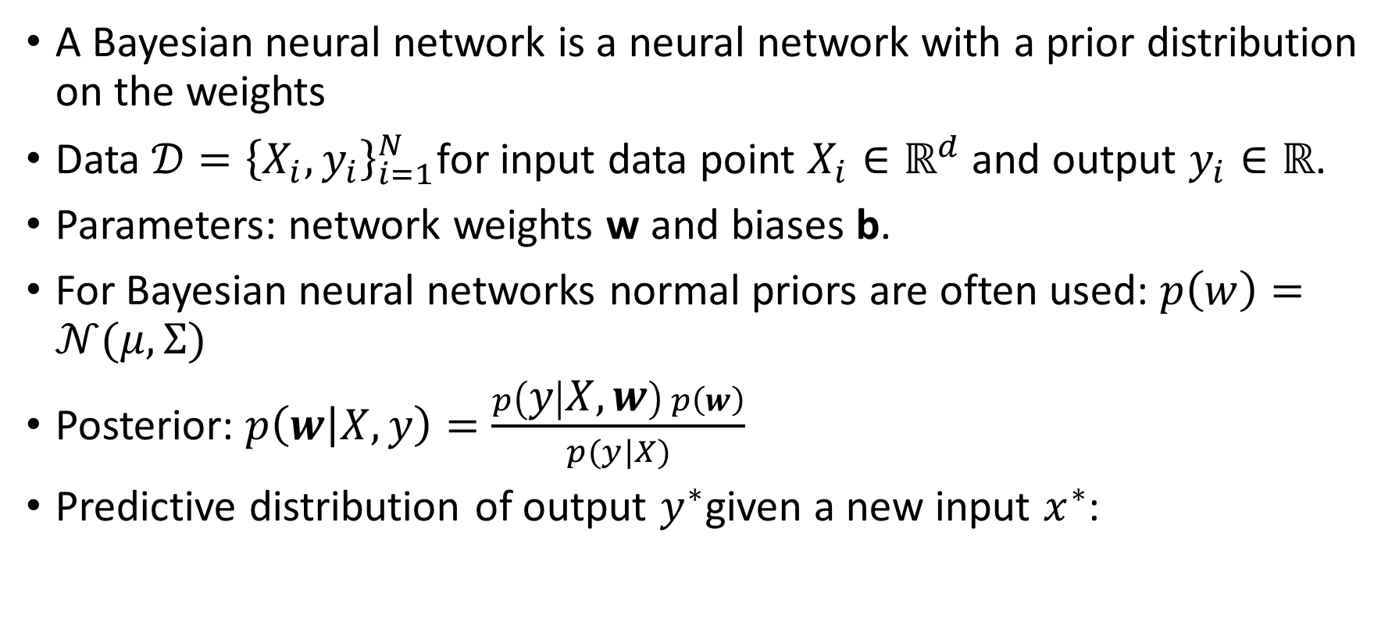
Bayesian Neural Networks
A Bayesian neural network is a neural network with a prior distribution on the weights
Data $𝒟={\left\{X_{i},y_{i}\right\}}_{i=1}^{N}$for input data point $X_{i}∈ℝ^{d}$ and output $y_{i}∈ℝ$.
Parameters: network weights w and biases b.
For Bayesian neural networks normal priors are often used: $p\left(w\right)=𝒩(μ,Σ)$
Posterior: $p\left(w | X,y\right)=\frac{p\left(y | X,w\right) p\left(w\right)}{p(y|X)}$
Predictive distribution of output $y^{∗}$given a new input $x^{∗}$:
$$p\left(y^{∗} | x^{∗},X,y\right)=\int{p\left(y^{∗} | x^{∗},w\right)p\left(w | X,y\right)dw}$$

Slide 4
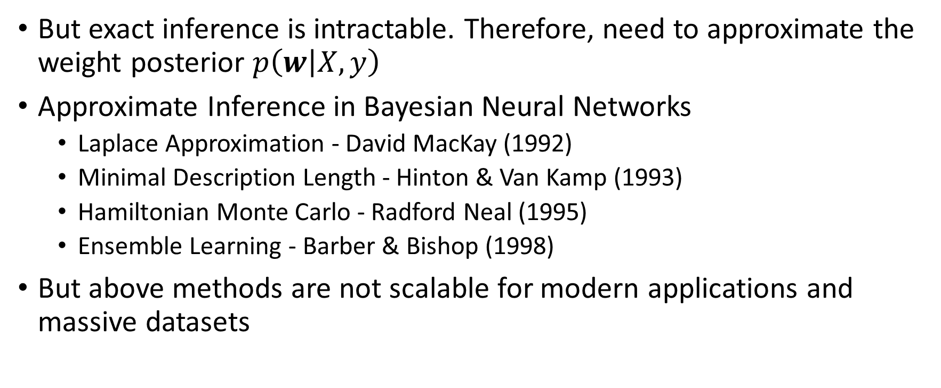
Bayesian Neural Networks
But exact inference is intractable. Therefore, need to approximate the weight posterior $p\left(w | X,y\right)$
Approximate Inference in Bayesian Neural Networks
Laplace Approximation - David MacKay (1992)
Minimal Description Length - Hinton & Van Kamp (1993)
Hamiltonian Monte Carlo - Radford Neal (1995)
Ensemble Learning - Barber & Bishop (1998)
But above methods are not scalable for modern applications and massive datasets

Slide 5
Content
Bayesian Neural Networks
Variational Inference
Dropout Method
Dropout as a Bayesian Approximation
Extensions
Evaluation Criteria for predictive maintenance
References

Slide 6
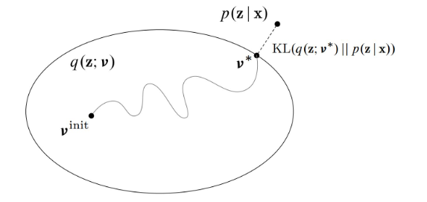



Bayesian inference as optimization – Variational Inference
Approximate the posterior $p\left(w | X,y\right)$with a simpler distribution from a variational family of distributions $q_{θ}(w)$parameterized by $θ$
Minimize the Kullback-Leibler (KL) divergence between approximate posterior $q_{θ}(w)$and the actual posterior $p\left(w | X,y\right)$w.r.t. $θ$
Mean Field approximation: factories the approximating posterior $q_{θ}(w)$into independent distributions for each weight layer
$$KL[q_{θ}\left(z\right)||p\left(z\right)]$$
$$q_{θ}(z)$$

Slide 7
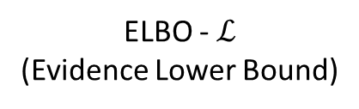

Bayesian inference as optimization – Variational Inference
But minimizing KL divergence is hard! $KL(q|\left|p\right)=−\sum_{z}{q\left(z\right)\ln{\frac{p(Z|X)}{q(Z)}}}$
Minimizing the KL divergence = maximizing the Evidence Lower Bound (ELBO) w.r.t. θ
$KL(q|\left|p\right)+$ $\sum_{z}{q\left(z\right)\ln{\frac{p(X,Z)}{q(Z)}}}=\ln{p(x)}$
KL
+
ELBO - $ℒ$ (Evidence Lower Bound)
=
Constant

Slide 8
Content
Bayesian Neural Networks
Variational Inference
Dropout Method
Dropout as a Bayesian Approximation
Extensions
Evaluation Criteria for predictive maintenance
References

Slide 9
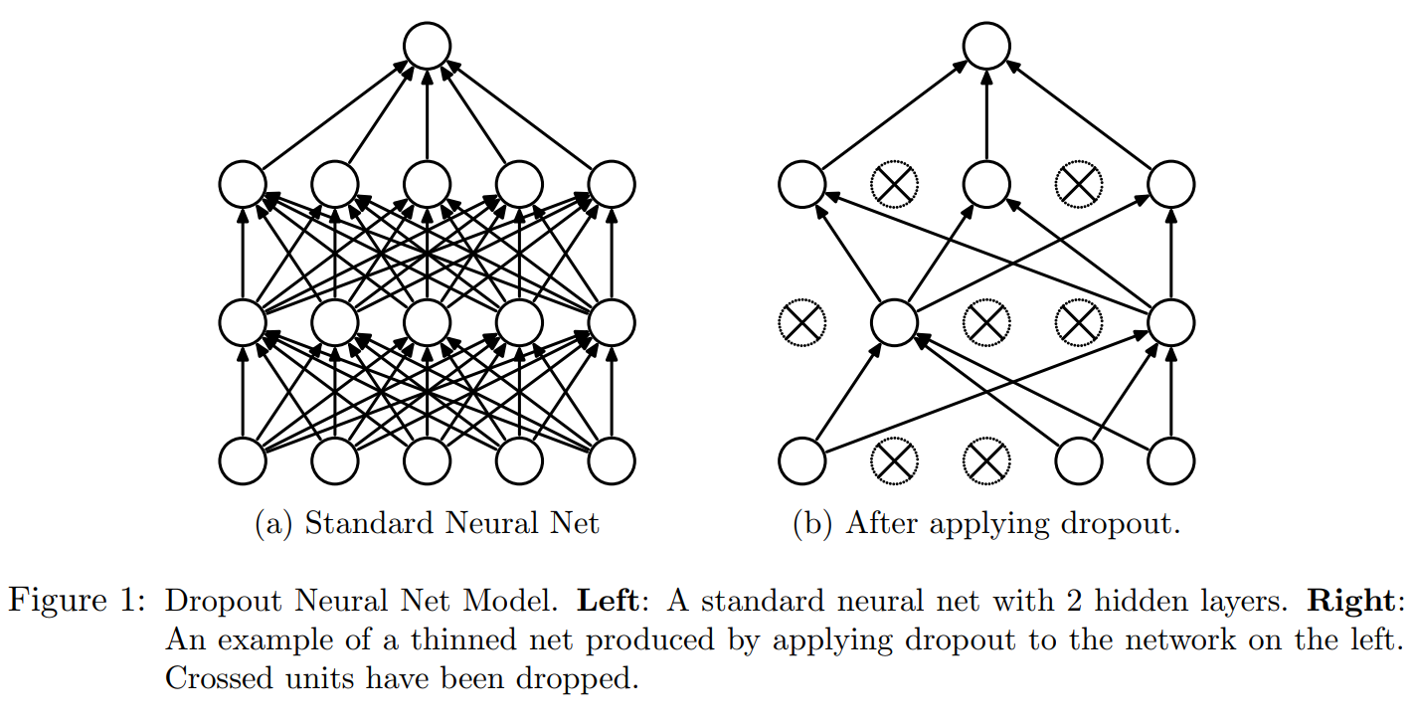
Dropout
Deep neural networks: many parameters; very prone to overfitting; require large data sets
Dropout is an empirical technique used to avoid overfitting in neural networks
Dropout multiplies hidden activations by Bernoulli distributed random variables which take the value 1 with probability p and 0 otherwise
Randomly "drop out" hidden units and their connections during training time to prevents hidden units from co-adapting too much
Often yields significant improvements over other regularization methods

Slide 10
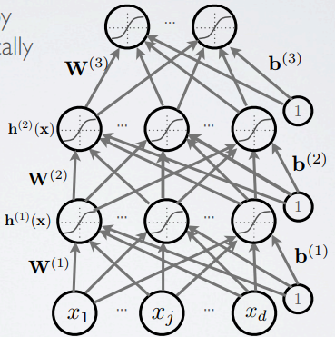
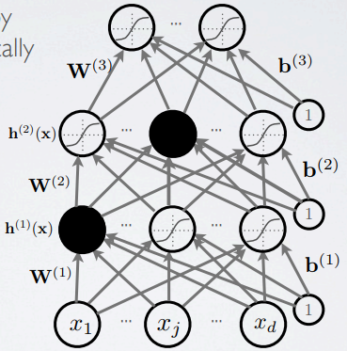
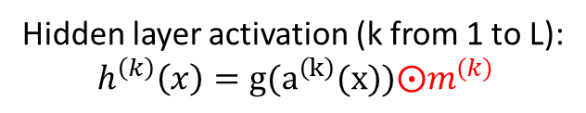
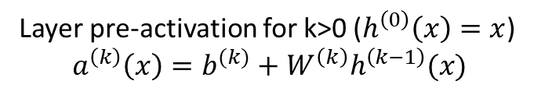
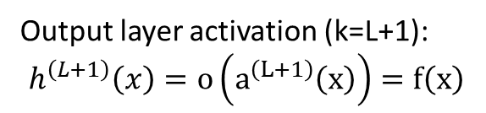
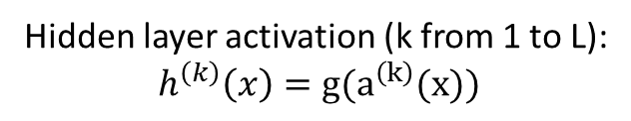
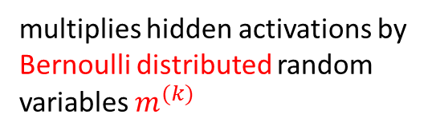
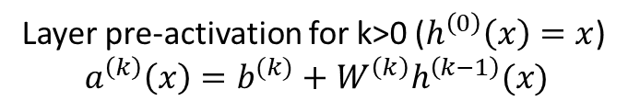
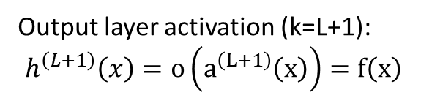
Dropout
multiplies hidden activations by Bernoulli distributed random variables $m^{(k)}$
Layer pre-activation for k>0 ($h^{\left(0\right)}\left(x\right)=x$)
$$a^{\left(k\right)}\left(x\right)=b^{(k)}+W^{\left(k\right)}h^{\left(k−1\right)}(x)$$
Layer pre-activation for k>0 ($h^{\left(0\right)}\left(x\right)=x$)
$$a^{\left(k\right)}\left(x\right)=b^{(k)}+W^{\left(k\right)}h^{\left(k−1\right)}(x)$$
Hidden layer activation (k from 1 to L):
$$h^{\left(k\right)}\left(x\right)=g(a^{\left(k\right)}(x))$$
Hidden layer activation (k from 1 to L):
$$h^{\left(k\right)}\left(x\right)=g(a^{\left(k\right)}(x))⨀m^{(k)}$$
Output layer activation (k=L+1):
$$h^{\left(L+1\right)}\left(x\right)=o\left(a^{\left(L+1\right)}\left(x\right)\right)=f\left(x\right)$$
Output layer activation (k=L+1):
$$h^{\left(L+1\right)}\left(x\right)=o\left(a^{\left(L+1\right)}\left(x\right)\right)=f\left(x\right)$$

Slide 11
Content
Bayesian Neural Networks
Variational Inference
Dropout Method
Dropout as a Bayesian Approximation
Extensions
Evaluation Criteria for predictive maintenance
References

Slide 12
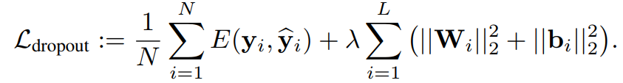
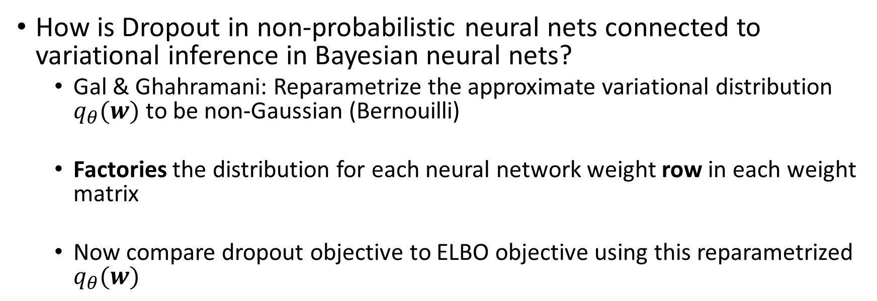
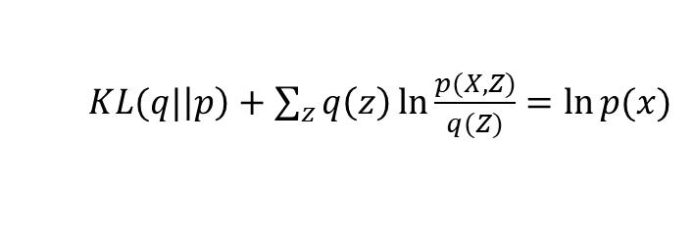
Dropout Objective
How is Dropout in non-probabilistic neural nets connected to variational inference in Bayesian neural nets?
Gal & Ghahramani: Reparametrize the approximate variational distribution $q_{θ}(w)$to be non-Gaussian (Bernouilli)
Factories the distribution for each neural network weight row in each weight matrix
Now compare dropout objective to ELBO objective using this reparametrized $q_{θ}(w)$
$KL(q|\left|p\right)+$ $\sum_{z}{q\left(z\right)\ln{\frac{p(X,Z)}{q(Z)}}}=\ln{p(x)}$

Slide 13
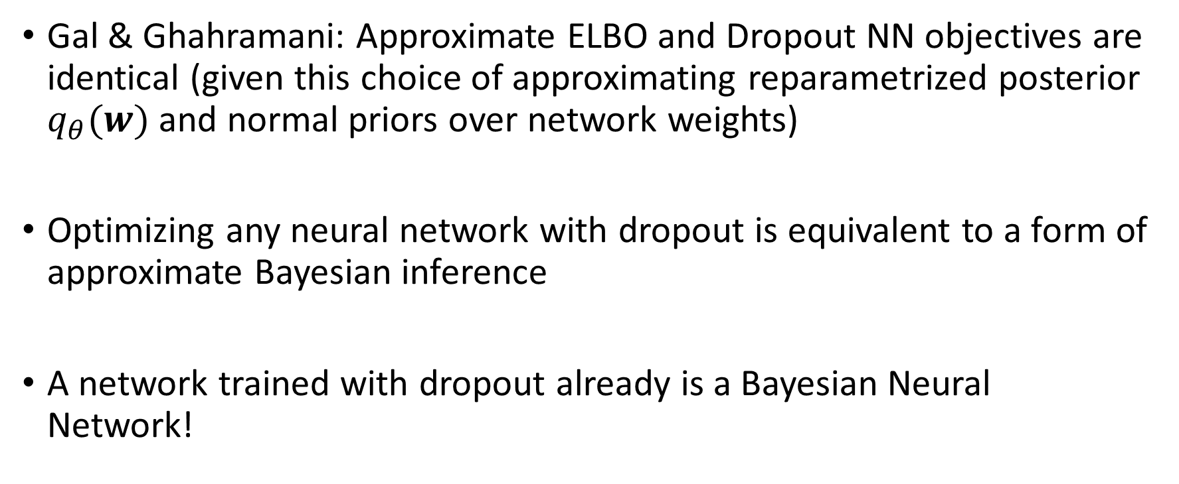
Dropout as a Bayesian Approximation
Gal & Ghahramani: Approximate ELBO and Dropout NN objectives are identical (given this choice of approximating reparametrized posterior $q_{θ}(w)$and normal priors over network weights)
Optimizing any neural network with dropout is equivalent to a form of approximate Bayesian inference
A network trained with dropout already is a Bayesian Neural Network!

Slide 14
Dropout as a Bayesian Approximation
Gal and Ghahramani's method (MC Dropout) requires applying dropout at every weight layer at test time
MC Dropout averages over T forward passes through the network at test time
To estimate predictive mean and predictive uncertainty:
Simply collect the results of stochastic forward passes through an existing Neural Network already trained with Dropout!

Slide 15
Content
Bayesian Neural Networks
Variational Inference
Dropout Method
Dropout as a Bayesian Approximation
Extensions
Evaluation Criteria for predictive maintenance
References

Slide 16
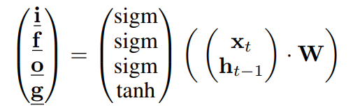
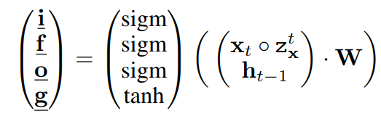
MC Dropout extensions
Convolutional Neural Networks: Bayesian Convolutional Neural Networks with Bernoulli Approximate Variational Inference, Y Gal, Z Ghahramani, ICLR 2016
“apply dropout after all convolution layers as well as inner-product layers”
Recurrent Neural Networks: A Theoretically Grounded Application of Dropout in Recurrent Neural Networks, Y Gal, Z Ghahramani, NIPS 2016
When apply MC Dropout
Time-dependent $z_{x}^{t}$ which is sampled anew every time step from a Bernoulli distribution

Slide 17
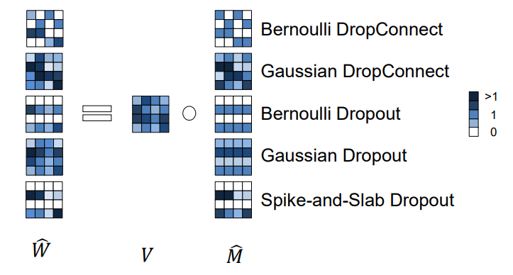

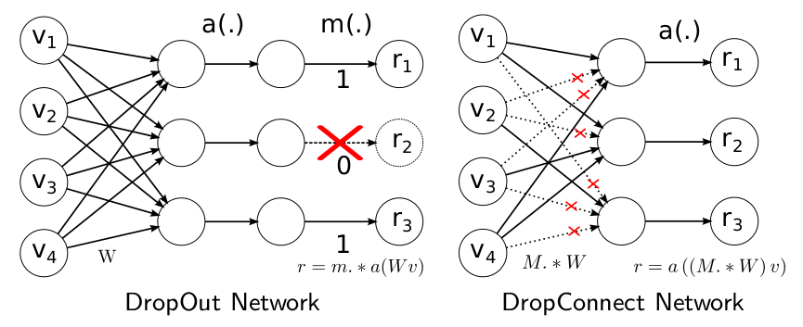
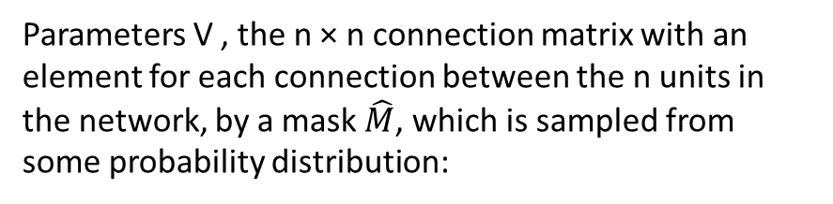
Variations of MC Dropout
Parameters V , the n × n connection matrix with an element for each connection between the n units in the network, by a mask $\hat{M}$, which is sampled from some probability distribution:
An illustration of sampling network weights using the different variational distributions.

Slide 18
Content
Bayesian Neural Networks
Variational Inference
Dropout Method
Dropout as a Bayesian Approximation
Extensions
Evaluation Criteria for predictive maintenance
References

Slide 19
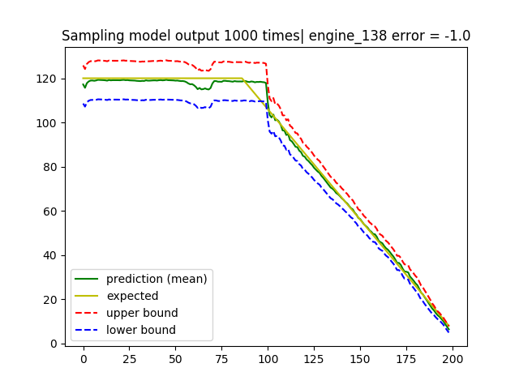
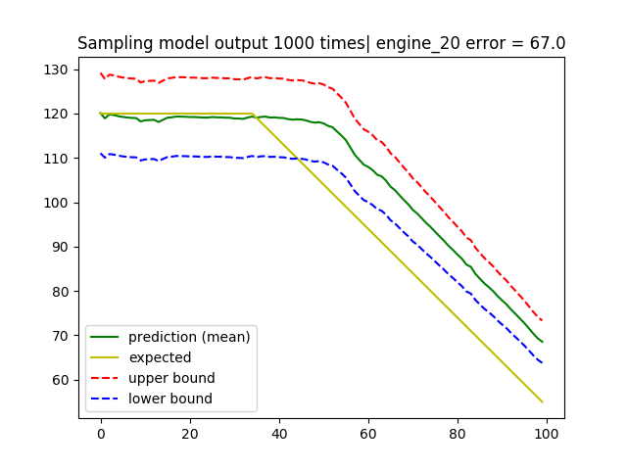
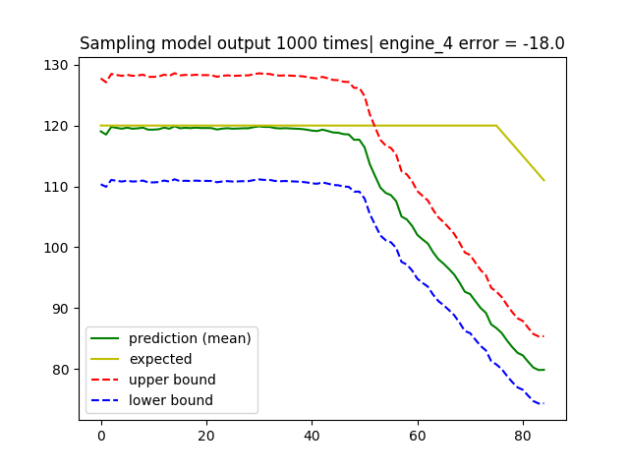
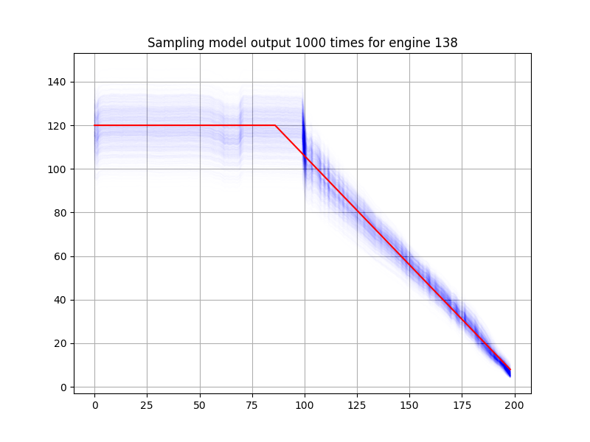
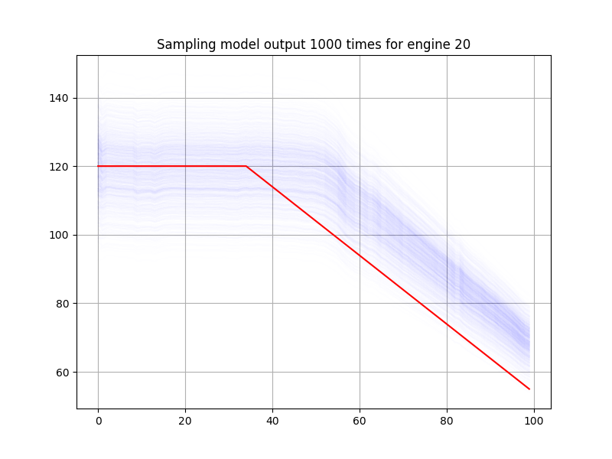
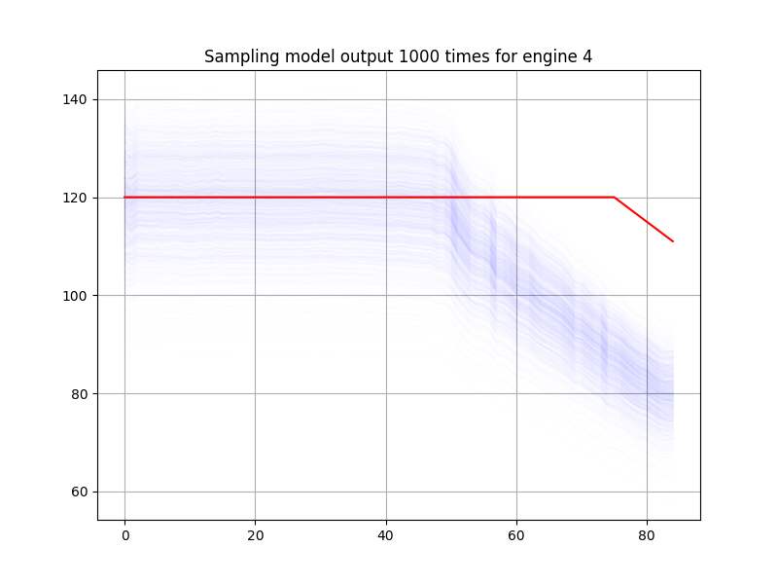
Results for CMAPSS dataset with MC Dropout

Slide 20
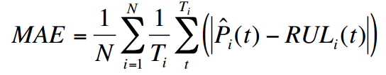
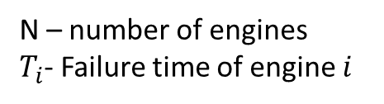
Prognostic Model Performance Evaluation
Mean Absolute Error (Standard Model Evaluation Metrics)
These metrics are useful for comparing separate models built upon similar data, or data from systems with comparable lifetime scales, but give no clear indication of prediction performance without some context to the data.
Unfortunately as far as prognostics is concerned predictions near the end of a unit or system’s lifetime are much more critical than those near the beginning of life.
Therefore, priority need to be increase when moving from beginning to the end of the machine life.
N – number of engines
$T_{i}$- Failure time of engine $i$

Slide 21
Traditional Hierarchical Based Metrics
Is prediction becomes within acceptable bounds
Is prediction remain in the acceptable bunds
One minus the percent difference of the prediction to the true value
How quickly the prediction arrive at the final answer

Slide 22
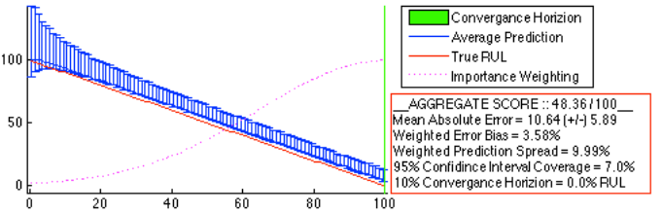
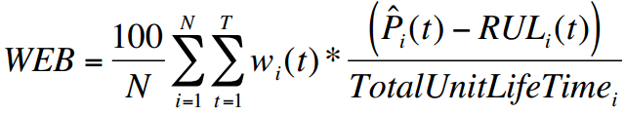
Weighted Error Bias (WEB)
A model whose predictions yield a 10%WEB would be expected to be better than one with a 25%WEB regardless of the systems, equipment, or time scales involved.
In order to give more priority to the end of the life cycle, one can choose a Gaussian kernel Function with a mean value set to the lifetime of the engine and a standard deviation set to 50% or 30% of that lifetime.
0% WPS alone would seem to indicate absolute certainty in all predicted values, but this may be misleading.

Slide 23
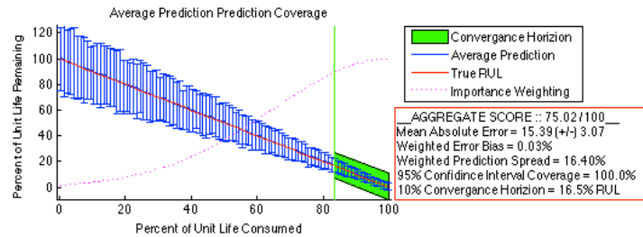
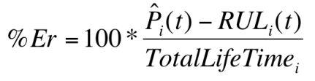
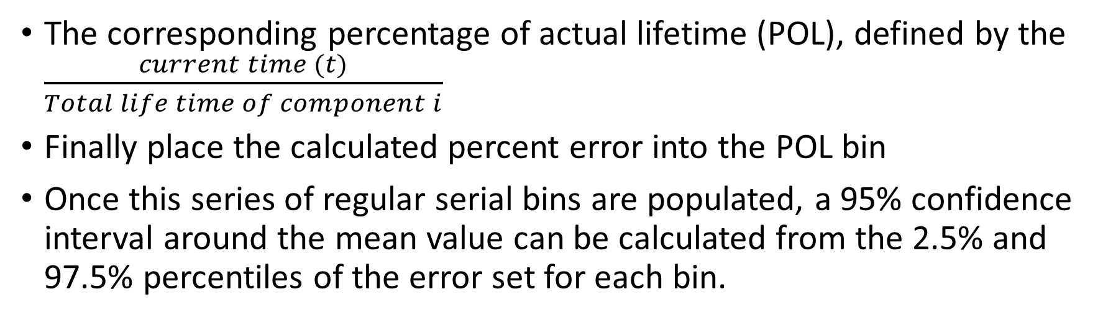
Percent Error Value Binning
The corresponding percentage of actual lifetime (POL), defined by the $\frac{current time (t)}{Total life time of component i}$
Finally place the calculated percent error into the POL bin
Once this series of regular serial bins are populated, a 95% confidence interval around the mean value can be calculated from the 2.5% and 97.5% percentiles of the error set for each bin.

Slide 24
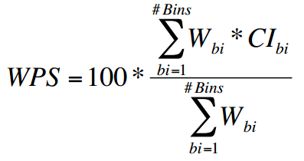
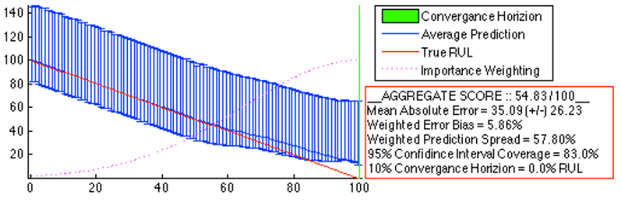

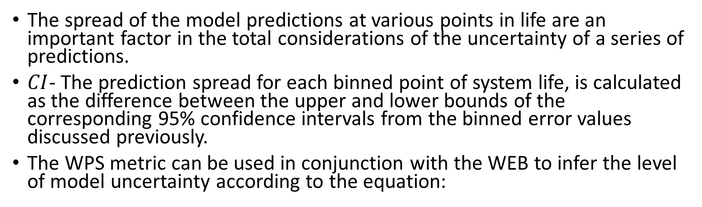
Weighted Prediction Spread
The spread of the model predictions at various points in life are an important factor in the total considerations of the uncertainty of a series of predictions.
$CI$- The prediction spread for each binned point of system life, is calculated as the difference between the upper and lower bounds of the corresponding 95% confidence intervals from the binned error values discussed previously.
The WPS metric can be used in conjunction with the WEB to infer the level of model uncertainty according to the equation:

Slide 25
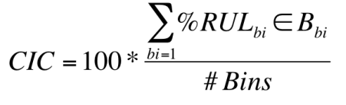
Confidence Interval Coverage
Next thing is to check is WPS>=WEB, which is whether the confidence interval of the prediction spread covers the true Remaining Useful Life (RUL).
This equation is interpreted as the sum number of true percent RUL values that are contained within their corresponding error bin set, and divided by the total number of bins and multiplied by 100 to convert to a percentage.
An optimal coverage of 100% shows that the true value of any prediction is contained within the prediction spread or approximate confidence interval of the prognostic model’s predictions.

Slide 26
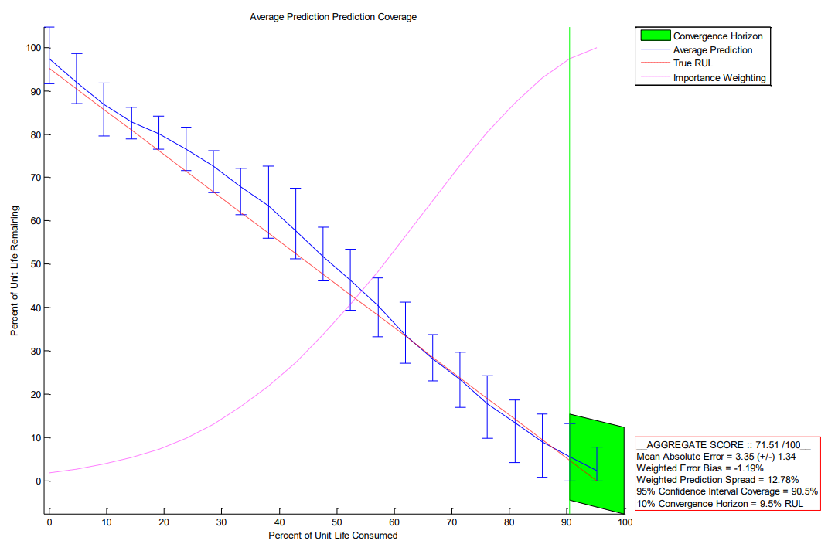
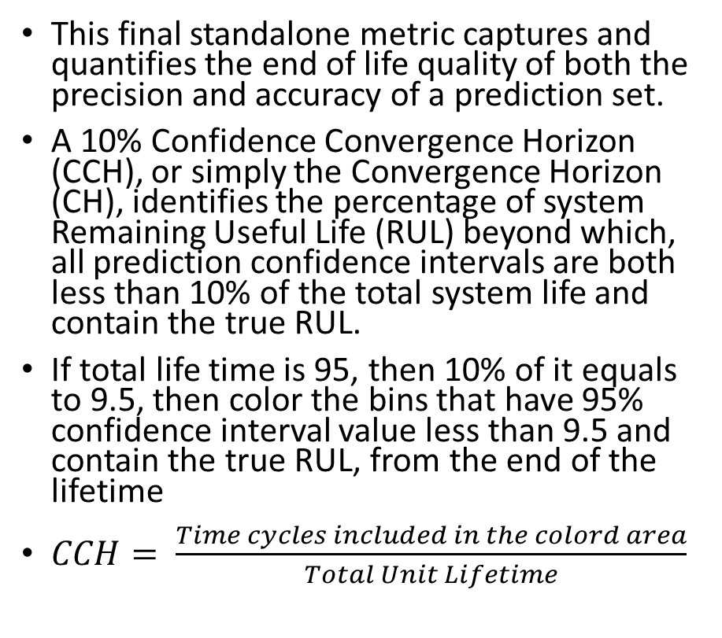
Confidence Convergence Horizon (CCH)
This final standalone metric captures and quantifies the end of life quality of both the precision and accuracy of a prediction set.
A 10% Confidence Convergence Horizon (CCH), or simply the Convergence Horizon (CH), identifies the percentage of system Remaining Useful Life (RUL) beyond which, all prediction confidence intervals are both less than 10% of the total system life and contain the true RUL.
If total life time is 95, then 10% of it equals to 9.5, then color the bins that have 95% confidence interval value less than 9.5 and contain the true RUL, from the end of the lifetime
$CCH= \frac{Time cycles included in the colord area}{Total Unit Lifetime}$

Slide 27
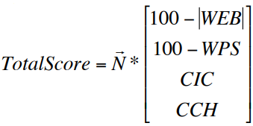
Total Score Metric
Both the absolute value of the WEB and the WPS are subtracted from 100 to reflect that the minimums of these values are the desired quantities.
N is any normalized vector weighting the importance of the four metrics. (eg: N = [.25 .25 .25 .25])

Slide 28
Summary
Metric Name | Quality Aspect Reflected | Units
Mean Absolute Error (MAE) | Precision: Average distance from true value | Real Time Units
Weighted Error Bias (WEB) | Timely Precision: Scaled expected distance from true value | Percent of Unit Life Weighted by Lifetime Importance
Weighted Prediction Spread (WPS) | Timely Accuracy: Scaled uncertainty estimate associated with each prediction | Percent of Unit Life Weighted by Lifetime Importance
Confidence Interval Coverage (CIC) | Accuracy: How often the estimated uncertainty contains the true value | Percent of Unit Life
Confidence Convergence Horizon (CCH) | Timely Accuracy & Precision: What part of life can all remaining estimates be trusted to within 10% | Percent of Unit Remaining Useful Life
Binned Prediction Value Map | Timely Accuracy & Precision: Detailed visualization of the evolution of the prognostic predictions. Used to calculate other metrics | Percent of Unit Life

Slide 29
Reference
Barbieri, F., Hines, W., Sharp, M., and Venturini, M., 2015, “Sensor-Based Degradation Prediction and Prognosis for Remaining Useful Life Estimation: Validation on Experimental Data of Electric Motors,” International Journal of Prognostics and Health Management, July 2015.
Sharp, M. (2013). Simple Metrics for Evaluating and Conveying Prognostic Model Performance To Users With Varied Backgrounds. International Journal of Prognostics and Health Management
Srivastava, Nitish, Hinton, Geoffrey, Krizhevsky, Alex, Sutskever, Ilya, and Salakhutdinov, Ruslan. Dropout: A simple way to prevent neural networks from overfitting. J. Mach. Learn. Res., 15(1):1929–1958, January 2014.
Yarin Gal and Zoubin Ghahramani. Dropout as a Bayesian approximation: Representing model uncertainty in deep learning. arXiv:1506.02142, 2015.
Yarin Gal and Zoubin Ghahramani. Bayesian convolutional neural networks with Bernoulli approximaten variational inference. arXiv:1506.02158, 2015.
Gal, Yarin. A theoretically grounded application of dropout in recurrent neural networks. arXiv preprint arXiv:1512.05287, 2015.
Patrick McClure and Nikolaus Kriegeskorte. Representing inferential uncertainty in deep neural networks through sampling. arXiv preprint arXiv:1611.01639, 2016.

Slide 30
Thank You

